Slide 1
GenAI and LLM

Slide 2

WHO AM I?
LinkedIn: https://www.linkedin.com/in/latha-t-k-b21018128/
Data Science ,AIML
Data Analysis ,SQL, PySpark
Data Visualization ,PowerBI, Tableau
Natural Language Processing (NLP)
Computer Vision
Generative AI, Prompt Engineering
BigData and Data Engineering

Slide 3


Slide 4


Slide 5


Slide 6


Slide 7


Slide 8


Slide 9
What is Data?

Slide 10
What is DATA?
Data is a collection of facts, figures, observations, or measurements that can be analyzed to gain insights.
It can be structured (like tables in a database) or unstructured (like text, images, or videos).
Data is crucial for decision-making in businesses, research, and technology.

Slide 11
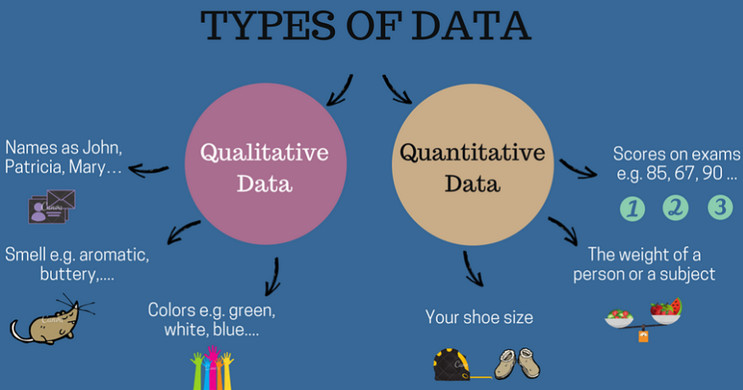

Slide 12
Part 1: Identifying Types of Data
Categorize each example as Qualitative (Categorical) or Quantitative (Numerical).
Customer satisfaction rating (Happy, Neutral, Sad)
Number of employees in a company
Price of a laptop (in ₹)
Name of a bank
Loan status (Approved/Rejected)
Annual revenue of a company

Slide 13
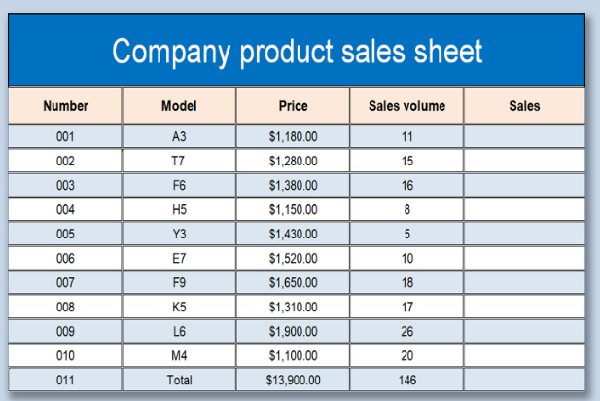
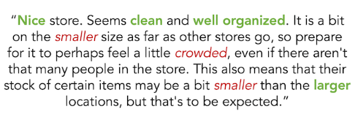

Slide 14
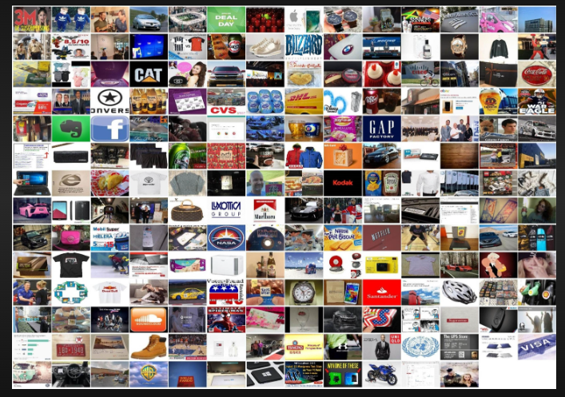
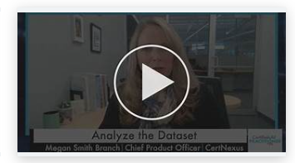
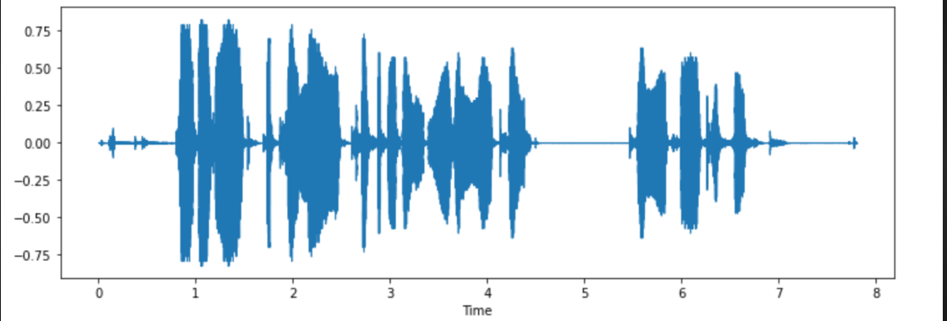

Slide 15
Structured or Unstructured?
Customer purchase history in a database
Video recordings of stock market news
Excel sheet with employee salary data
WhatsApp chat messages
Weather sensor readings

Slide 16
When to Use ML, CV, NLP, and DL?
Each technique—Machine Learning (ML), Computer Vision (CV), Natural Language Processing (NLP), and Deep Learning (DL)—is used based on the type of data and the problem being solved.

Slide 17
Machine Learning (ML)
Use ML when:
You have structured/tabular data (e.g., sales records, customer transactions).
You need to make predictions, classifications, or clustering.
Examples:
Predicting loan approvals (Classification)
Customer churn prediction
Fraud detection in banking
Recommender systems (Netflix, Amazon)

Slide 18
Computer Vision (CV)
Use CV when:
You are working with images or videos.
You need to analyze, classify, or generate images.
Examples:
Face recognition in security systems
Object detection in self-driving cars
Medical image analysis (e.g., detecting tumors in MRI scans)
Defect detection in manufacturing

Slide 19
Natural Language Processing (NLP)
Use NLP when:
You are working with text or speech data.
You need to understand, generate, or translate language.
Examples:
Chatbots and virtual assistants (Siri, Alexa)
Sentiment analysis of customer reviews
Machine translation (e.g., Google Translate)
Email spam detection

Slide 20
Deep Learning (DL)
Use DL when:
Your dataset is large and complex (images, speech, unstructured text).
Traditional ML models do not perform well.
You need high accuracy and have computational power (GPUs/TPUs).
Examples:
Autonomous driving (Self-driving cars)
Image generation (Deepfake technology)
Speech recognition (Google Assistant, Alexa)
Large Language Models (ChatGPT, Gemini,COPILOT)

Slide 21
Problem Statements
A bank wants to predict whether a customer will default on a loan based on transaction history and demographics.
A company wants to classify customer support emails as complaints, inquiries, or feedback.
A factory needs an AI system to detect defects in manufactured products by analyzing images.

Slide 22
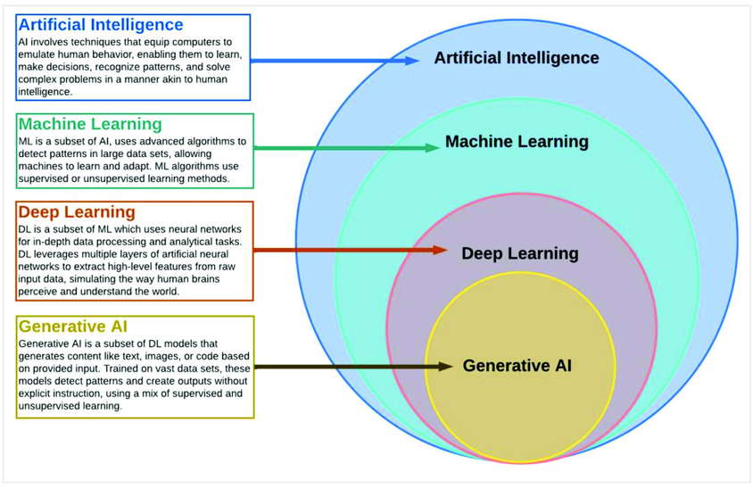

Slide 23
Types of Analytics
In today's data-driven world, information is king. But raw data itself isn't enough.
We need to analyze it to extract insights and make informed decisions

Slide 24






Slide 25
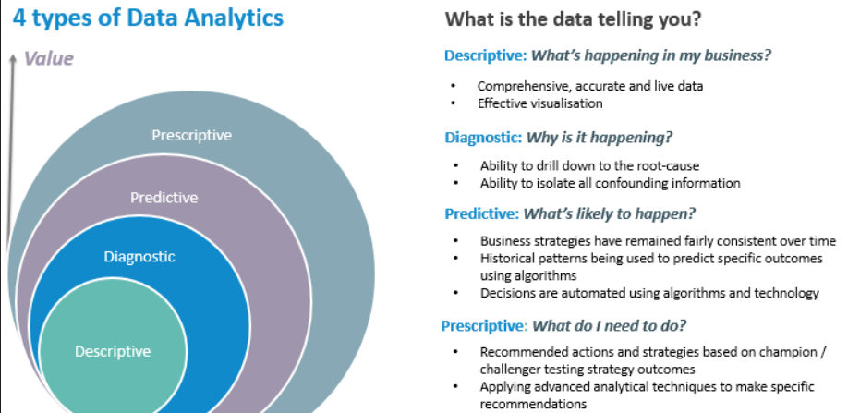

Slide 26
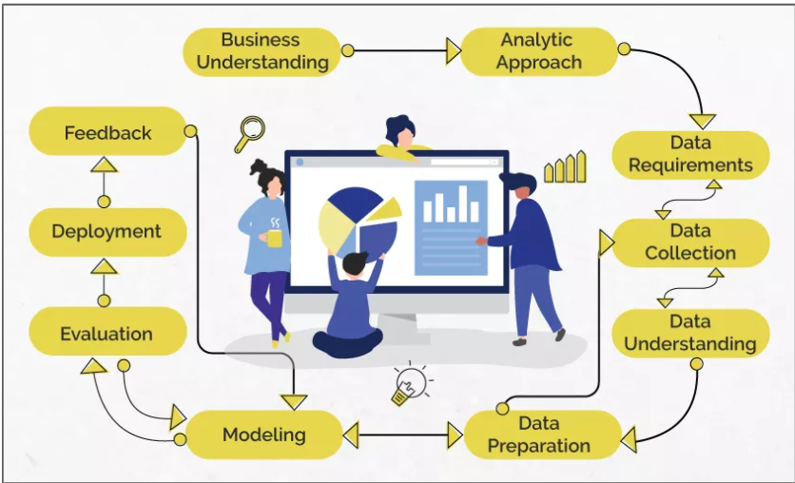
Data Science/Machine Learning

Slide 27
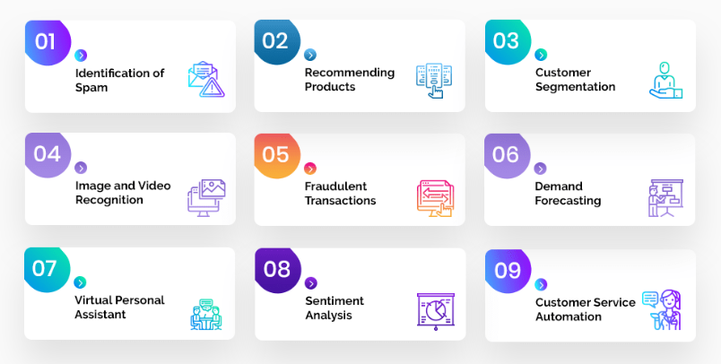
Problem Statement

Slide 28
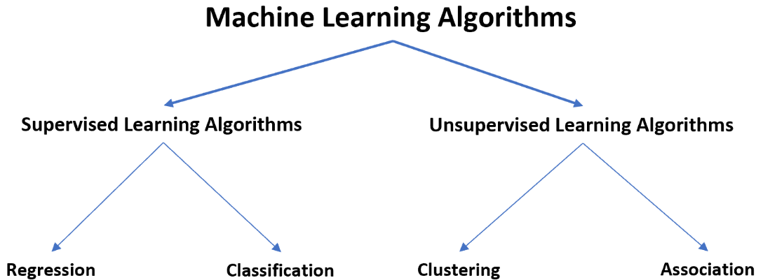

Slide 29
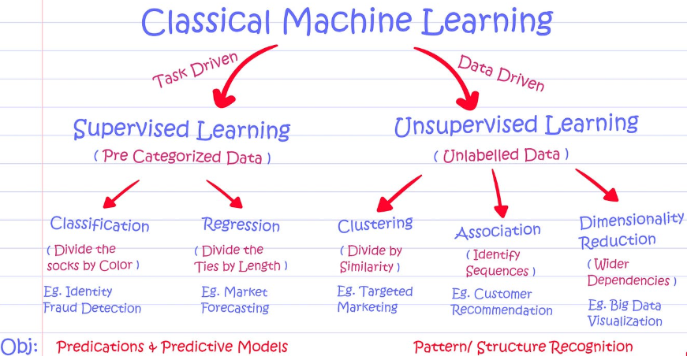

Slide 30
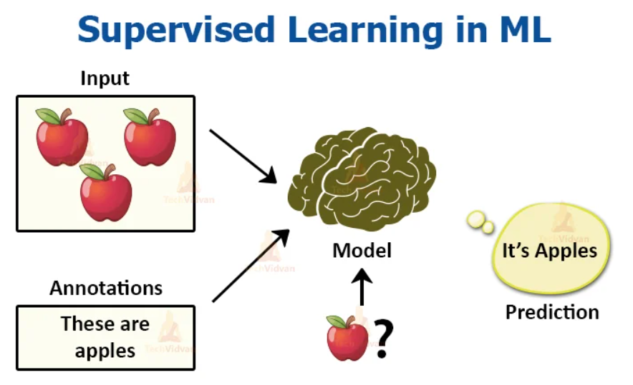

Slide 31
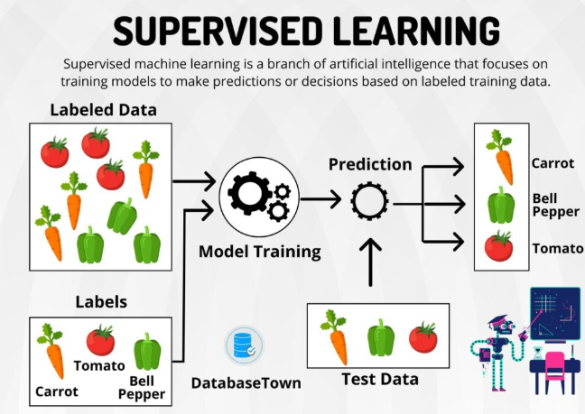

Slide 32
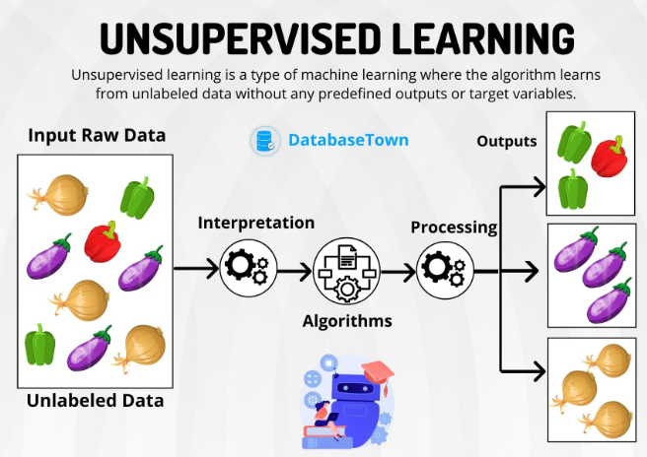

Slide 33
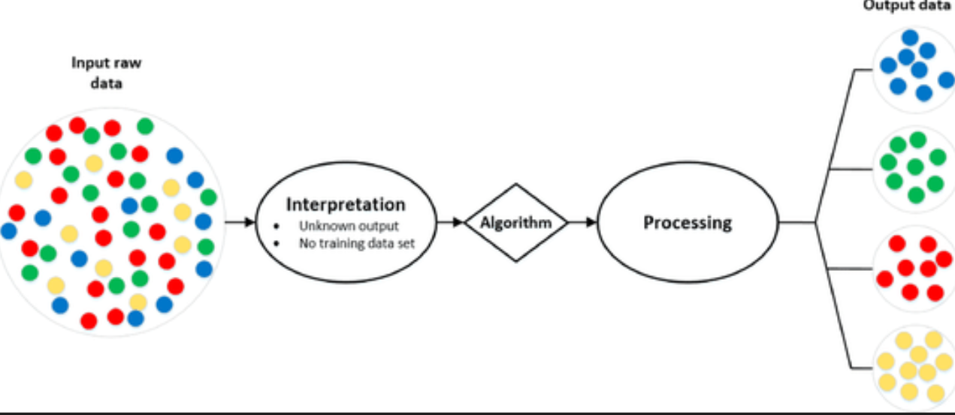
Analytic Approach

Slide 34
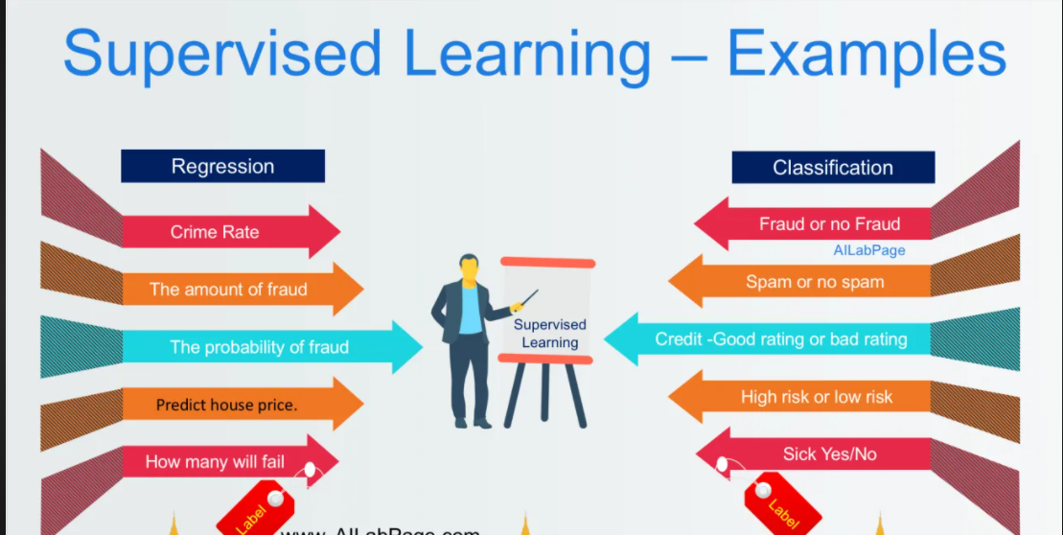
Supervised Learning

Slide 35
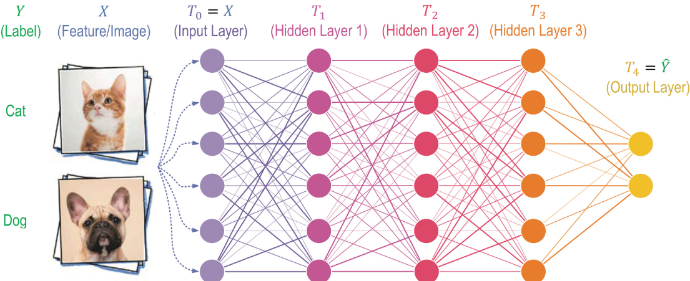

Slide 36
What is Prompt Engineering?
The practice of designing and refining prompts to optimize AI-generated responses.
Helps in guiding AI models like GPT-4 to produce relevant, accurate, and high-quality outputs.
Involves techniques like using clear instructions, providing context, and specifying output formats.
Used in applications such as chatbots, content generation, and decision-making systems.

Slide 37
Methods of Prompt Engineering
Zero-shot Prompting
Directly asking the model a question without examples.
Explain machine learning in simple terms.
What are the key factors affecting stock market prices?

Slide 38
Methods of Prompt Engineering
One-shot Prompting
Providing a single example to guide the AI’s response.
Example: “Translate ‘Hello’ to French: Bonjour. Now translate ‘Goodbye’.”

Slide 39
Methods of Prompt Engineering
One-shot Prompting:
If a person with a credit score of 750 and an income of $80,000 is approved for a loan, what about a person with a credit score of 680 and an income of $50,000?
Few-shot Prompting
A person with a credit score of 750 and income of $80,000 was approved.
A person with a credit score of 600 and income of $40,000 was denied.
A person with a credit score of 720 and income of $70,000 was approved.
Now, predict the loan decision for a person with a credit score of 680 and an income of $50,000."*

Slide 40
Methods of Prompt Engineering
Chain-of-Thought (CoT) Prompting
Encouraging step-by-step reasoning for complex problems.
Example: “Solve 24 × 3 + 12. First, multiply 24 by 3, then add 12.”
An investor is considering buying stocks in Company A. The company's revenue is growing at 10% per year, and it has a P/E ratio of 25. Interest rates are expected to rise next year. Should the investor buy the stock? Explain step by step.

Slide 41
Methods of Prompt Engineering
Role-based Prompting
Assigning a specific role to the AI for better responses.
Example: “You are a customer support agent. Answer the query professionally.”
You are a seasoned financial advisor. A client wants to invest ₹10 lakhs and is looking for low-risk options. Provide a step-by-step investment strategy.

Slide 42
Methods of Prompt Engineering
Persona-based Prompting
Making the AI respond in a particular style or tone.
Example: “Explain quantum physics as if you were a 5-year-old.”
You are the CFO of a multinational company. Your board is considering expanding into India. Analyze the financial risks and opportunities.

Slide 43
Methods of Prompt Engineering
Refinement and Iterative Prompting
Adjusting prompts based on initial responses for better results.
Example: If the response is too vague, rephrase with more details.

